Slide 1
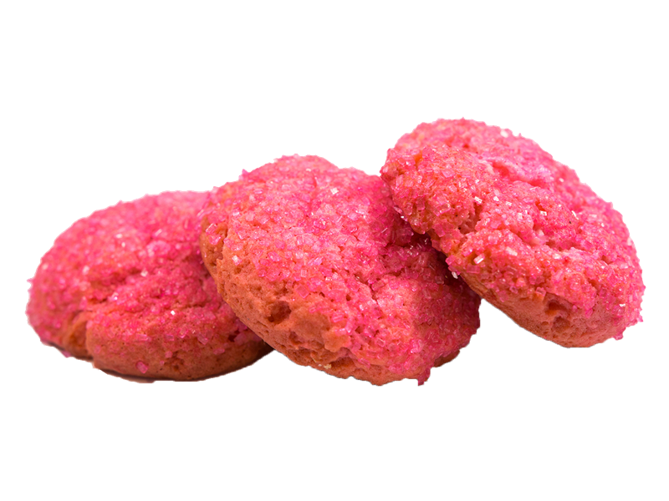
A PINK SOLUTION TO A COOKIE PROBLEM
DATATHON OCTOBER 2020 – TEAM PINK
Miguel Chacón, Jorge González, Nick Deitmers, Anna Fonte

Slide 2
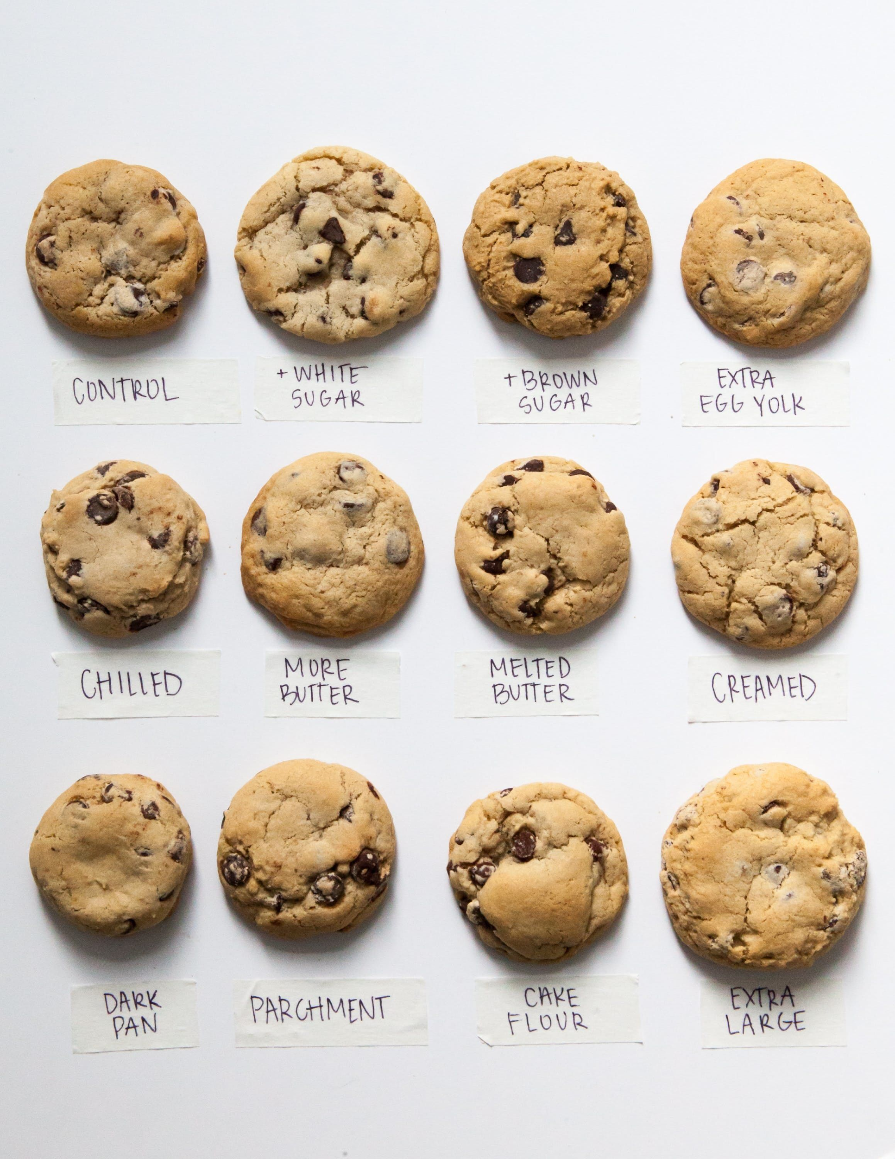
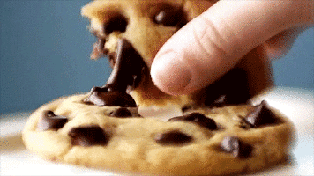
THE PROBLEM
Under and Over-stock of various cookie categories

Slide 3

THE TEAM
Yuyu
Cookie connoisseur
Nick
Dutch cookie monster
Anna
Professional cookie eater
Miguel
Professional baker

Slide 4


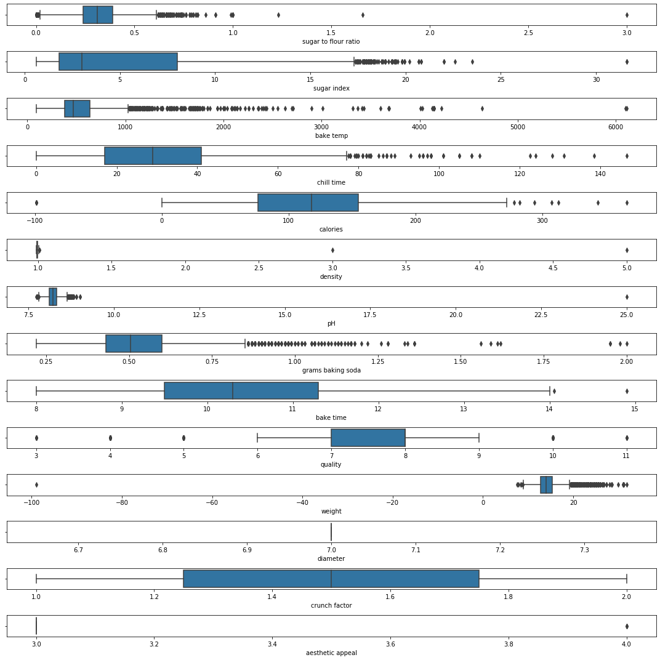

DATA CLEANING
Dropping rows with NaNs & Duplicates
Dropping Columns
Analysing Outliers

Slide 5
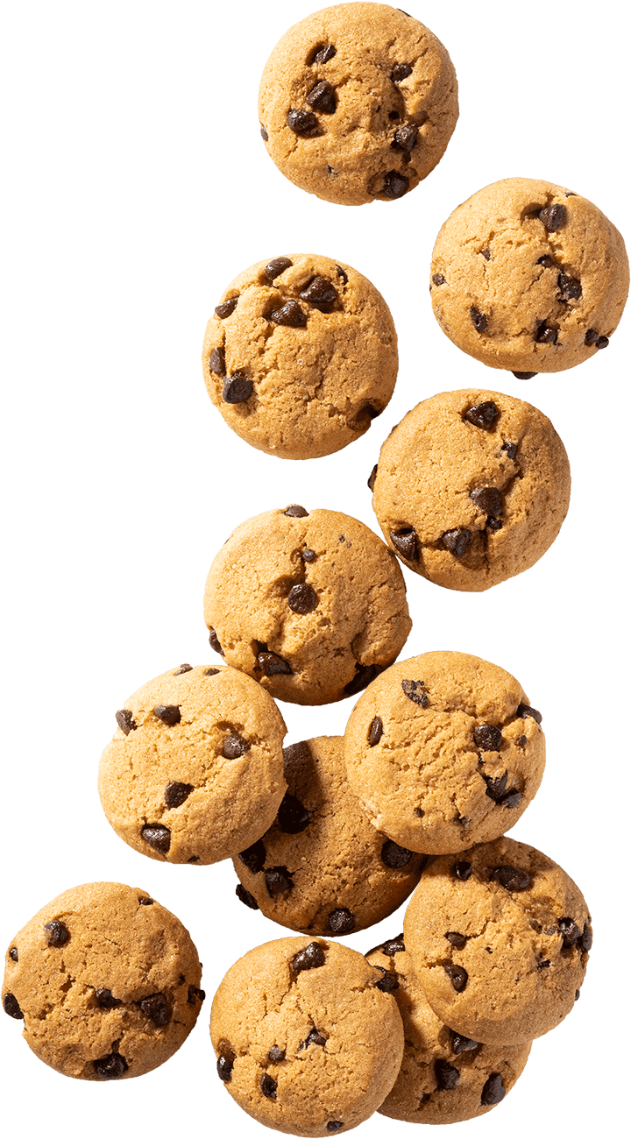

DATA PRE-PROCESSING
Data cleaning
Encoding categorical columns
Feature selection & engineering

Slide 6

MODELLING & HYPERPARAMETERS TUNING
Linear Regression
Random Forest Regression
Decision Tree Regression
Gradient Boosting Regression
KNN Regression
SVM Regression (killed our kernels)
Multi Layer Perceptron Regressor

Slide 7


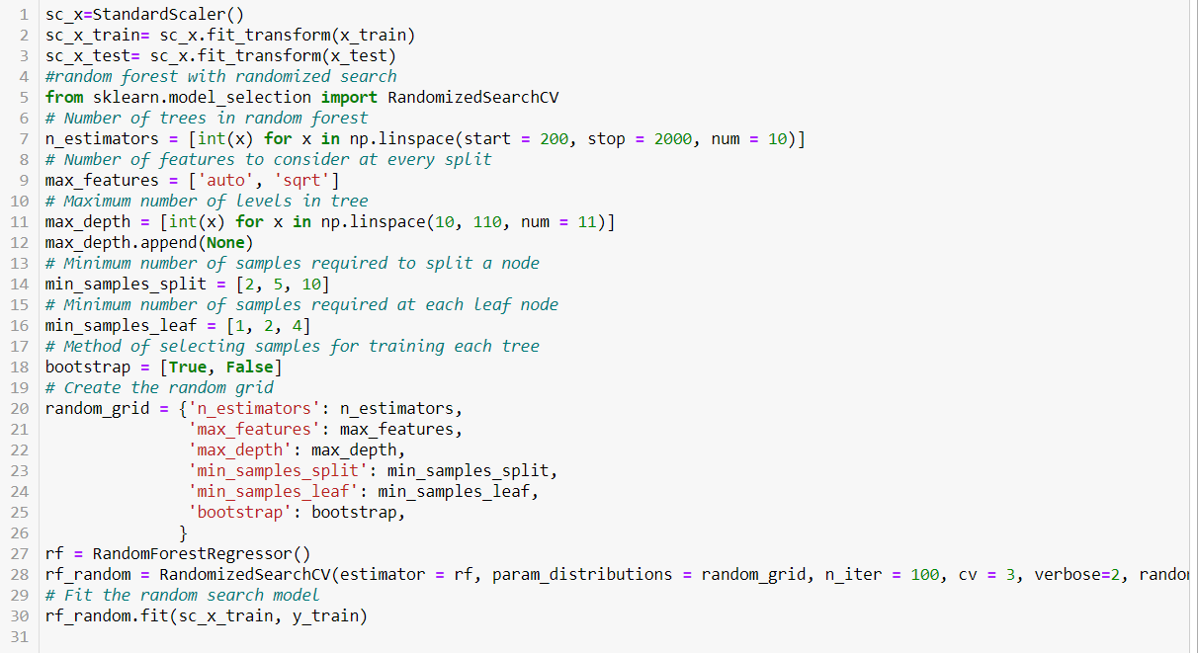

THE MODEL

Slide 8
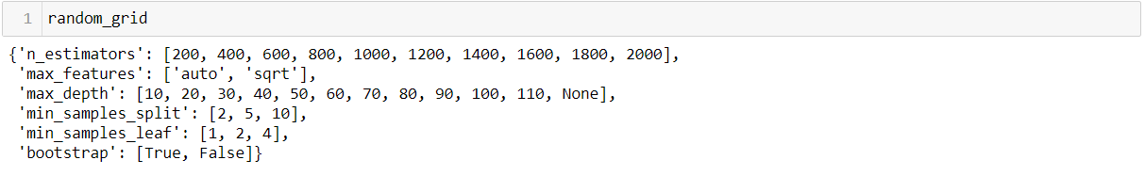
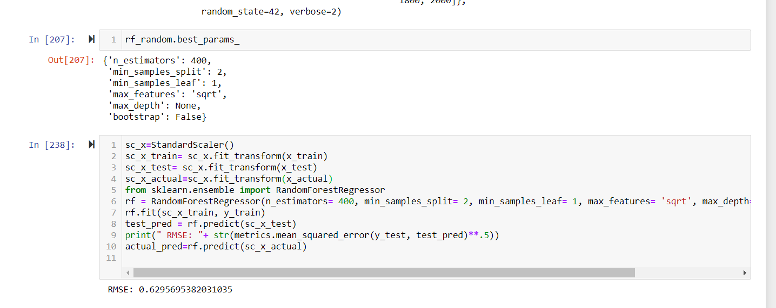

Slide 9

TIME’S UP!

